Slide 1
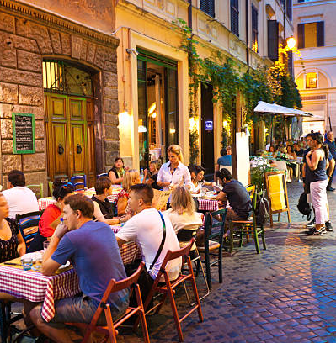
Business Final Project: European Restaurant Trends
Heather Swanke

Slide 2

Introduction
Client: European restaurant group seeking ideal location & features for a new restaurant
Impact: Group will create a new restaurant that is pleasing to customers
Measure of success: new restaurant achieves average customer rating of at least 4.0/5.0
Assumption: high customer reviews posted online → existing customers return and new customers gain interest

Slide 3
Methodology
Tripadvisor dataset found on Kaggle
Includes all restaurants registered on Tripadvisor in each city
Scraped in 2018
31 European cities
125,000+ total restaurants
127 different cuisine style tags
29 tags appeared under 50 times total
Data cleaning, transformation, & initial exploration completed in Excel
Visualizations completed in Tableau dashboards
Highly rated restaurant = average rating of 4.0 or higher

Slide 4
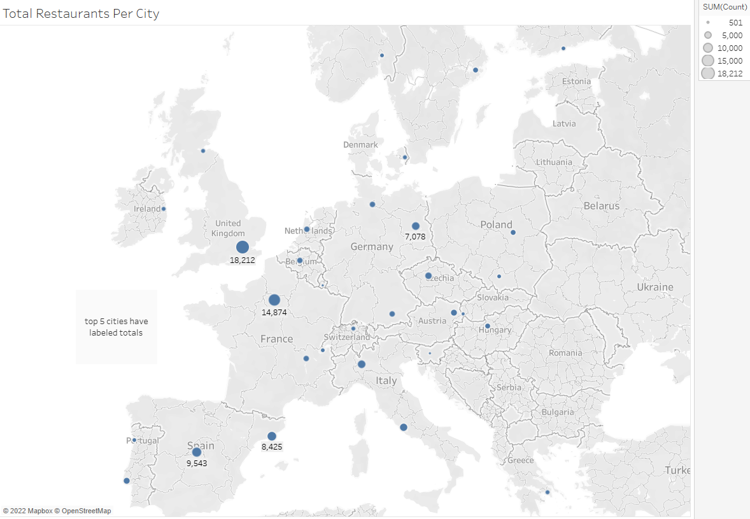
Results
Top 5:
London
Paris
Madrid
Barcelona
Berlin

Slide 5
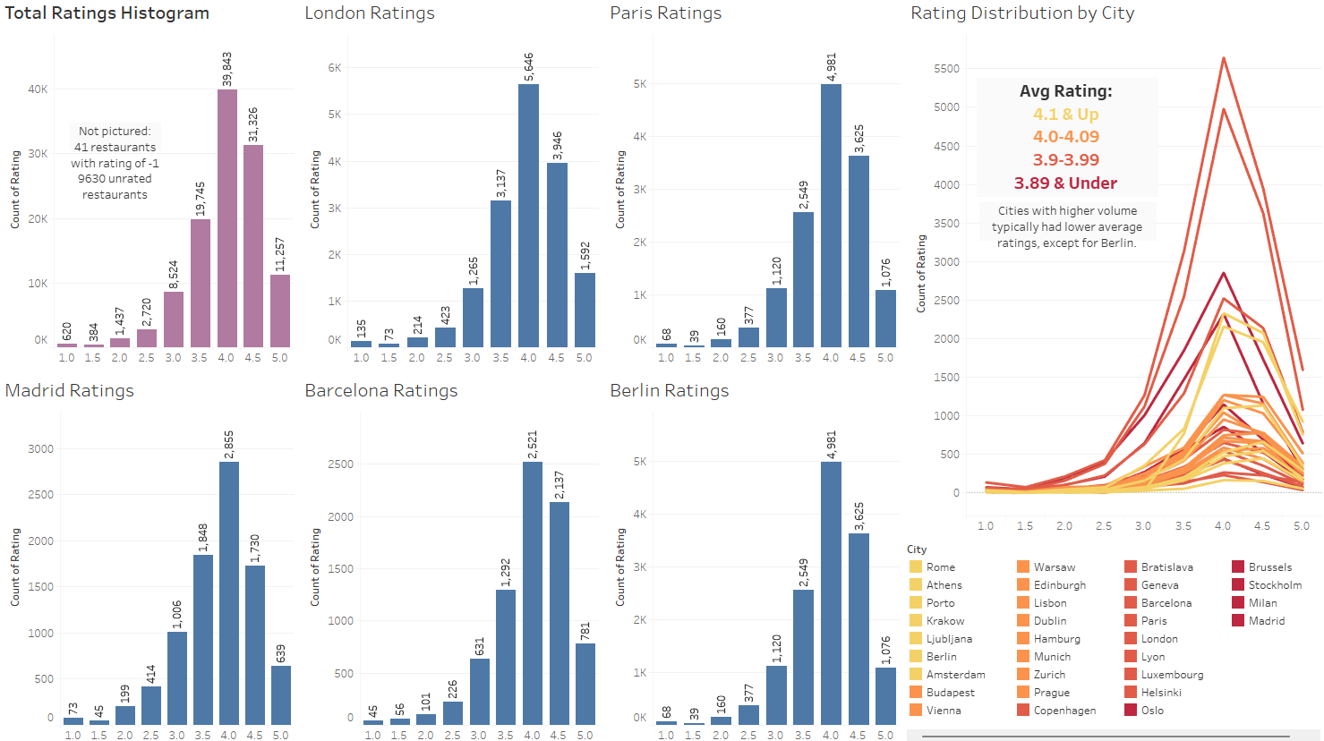
Less of high rating skew than other top cities
Cities here are ordered by avg rating. Happiest customers are in Rome & Athens!

Slide 6
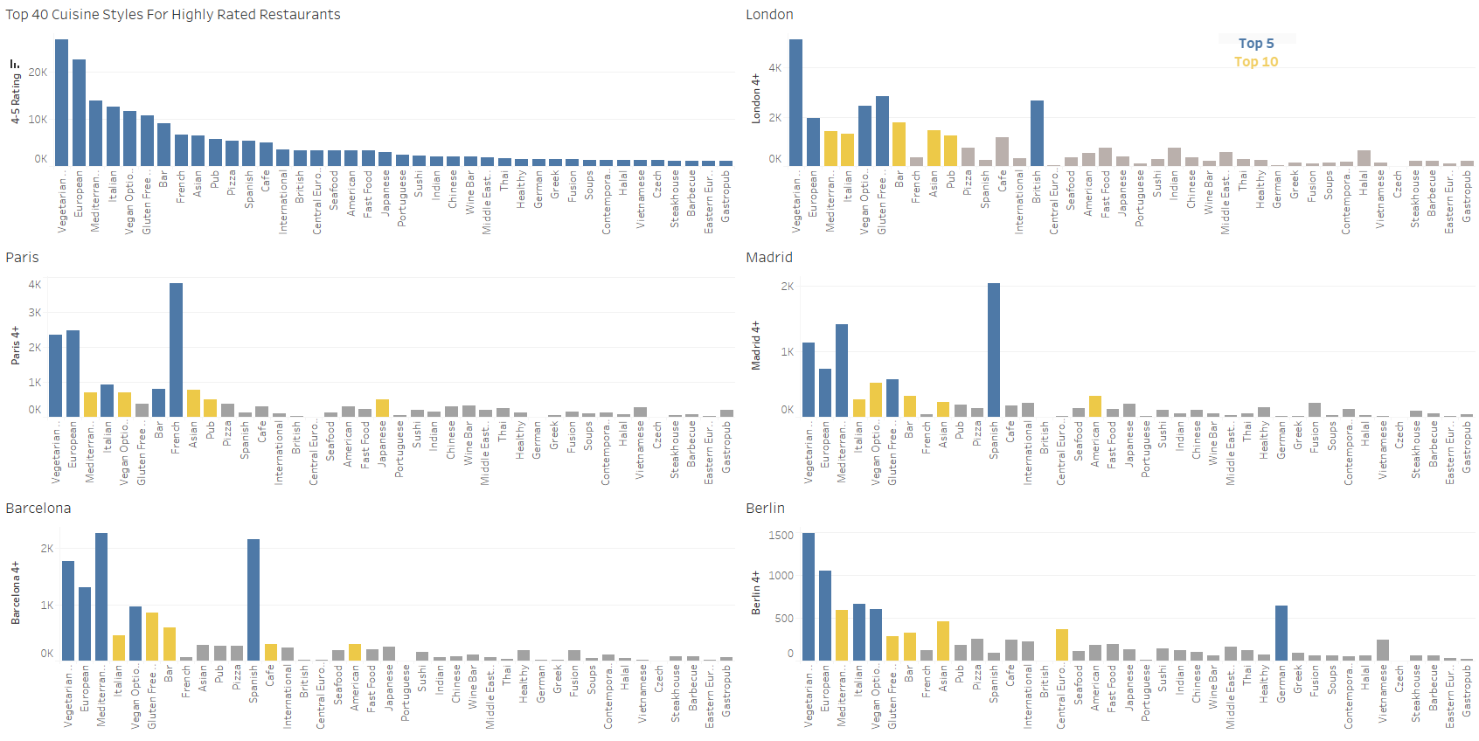
Vegetarian, Vegan & Gluten Free Friendly are consistent high performers
Native country’s cuisine are typically most popular ethnic cuisine style
Exception: Italian food outranked German food in Berlin
Ambience: bars in all cities and cafes in Barcelona
American food is popular in both Spanish cities

Slide 7
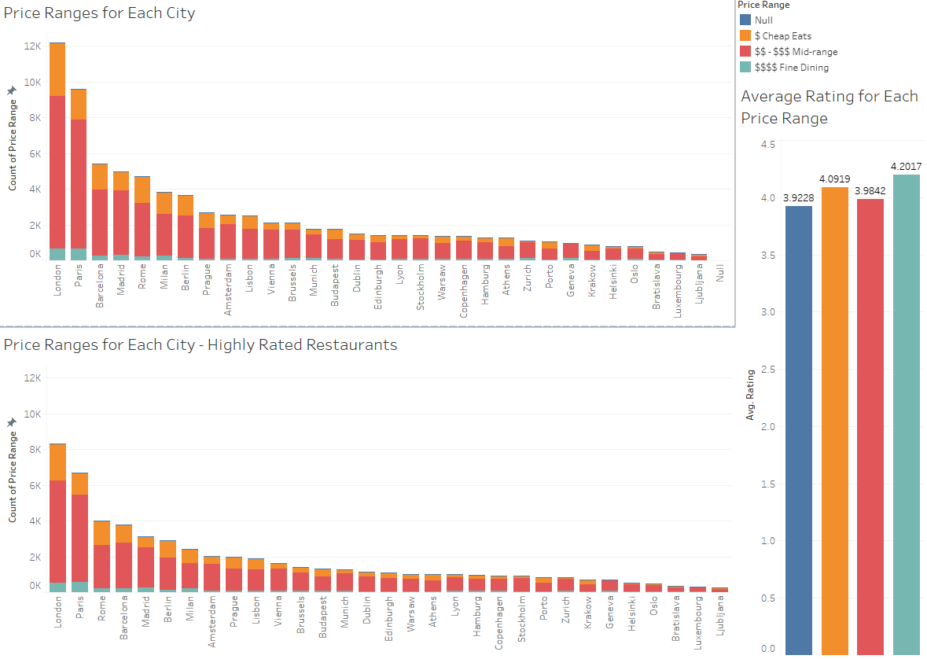
All 3 price ranges are represented in highly rated restaurants
Mid-range is most common, but average rating is slightly lower
Fine dining is a small market, but ratings are high

Slide 8
Conclusions
Berlin has a restaurant scene with high volume and high average ratings per restaurant
Italian food is the most popular ethnic cuisine style amongst highly rated restaurants in Berlin
Highly rated restaurants often have vegetarian, vegan and gluten-free options
Fine dining restaurants achieved highest average customer satisfaction
Best choice for opening new restaurant and achieving high customer reviews:
Fine dining Italian restaurant in Berlin

Slide 9
Data Science Recommendation/ Future Work
Tripadvisor dataset includes column with 2 reviews of each restaurant (review text and dates)
Sentiment analysis on review text strings can help identify keyword trends for positive & negative reviews
Implementing data science model could help client achieve even higher customer reviews at new restaurant
Applying sentiment analysis to restaurant review data based on other websites for new perspective
Are Tripadvisor reviews primarily from tourists or local customers?

Slide 10
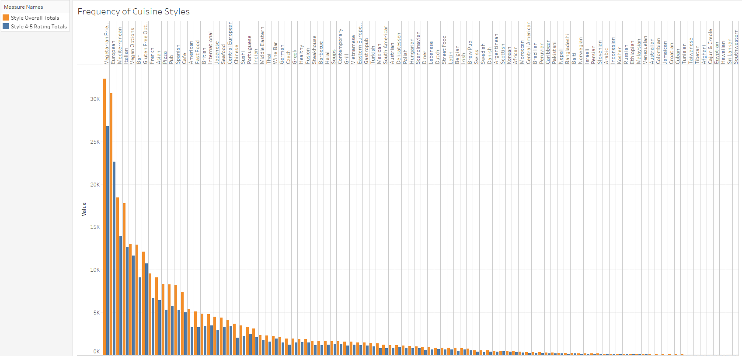
Appendix
Previously focused on popular cuisine styles for highly rated restaurants. Here I’m comparing most popular cuisine styles for restaurants overall with popular styles for highly rated restaurants.

Slide 11
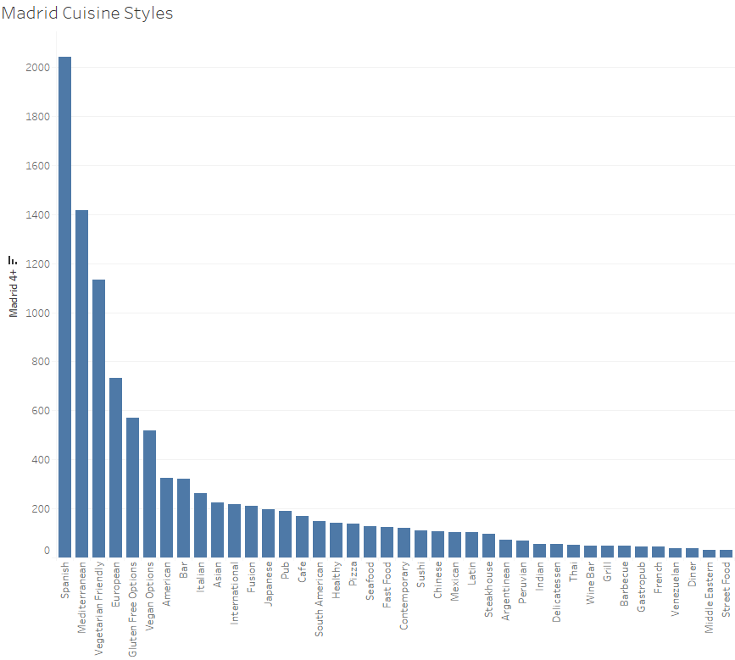
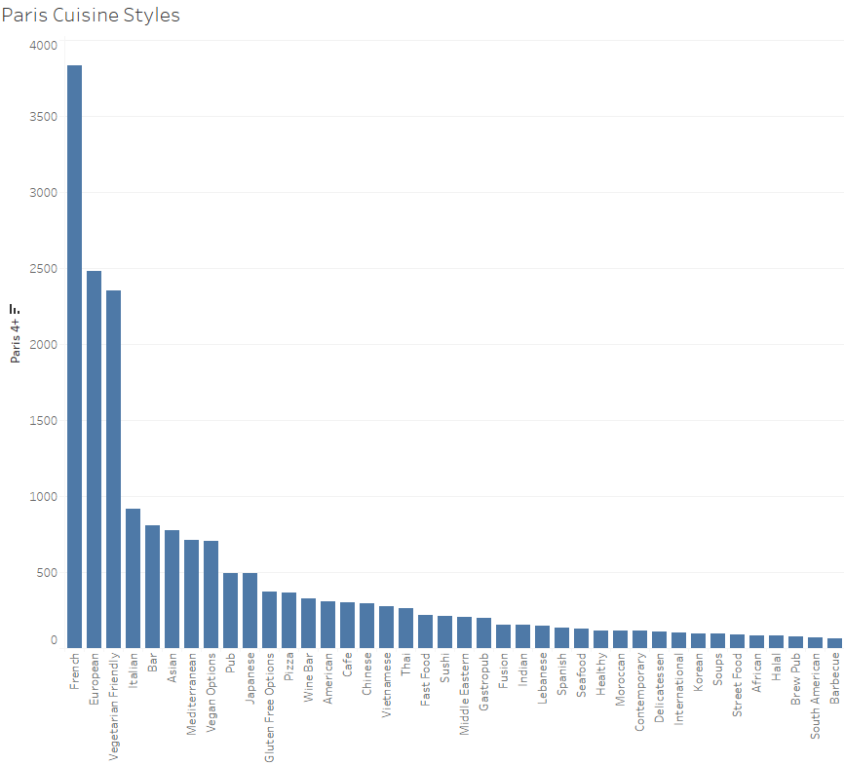
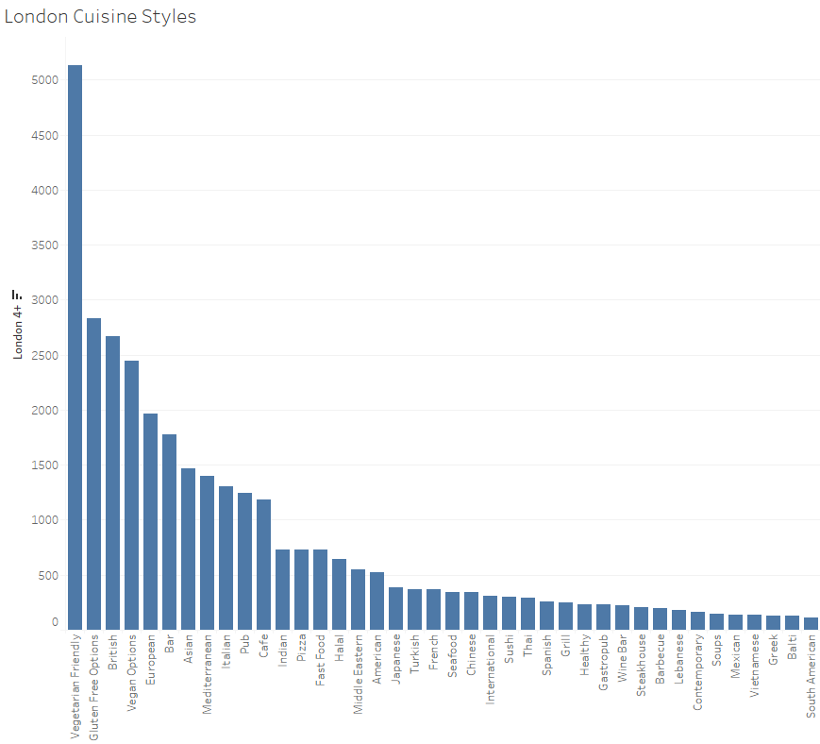
On previous cuisine styles dashboard, I maintained the overall style popularity order when looking at style details of each city. Here I’m sorting cuisines based on popularity amongst highly rated restaurants in each city. Note: top 40 displayed in screenshots, but original Tableau Public file displays 98 styles.

Slide 12
